Slide 1
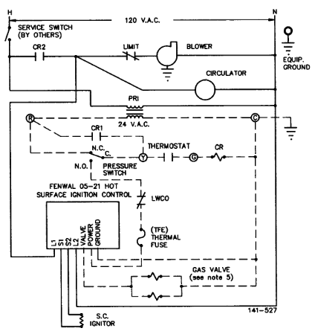
Show contact closure
Notes:
See that transformer is grounded

Slide 2
Notes:
See that transformer is grounded

Slide 3
Notes:
See that transformer is grounded

